Slide 1
Web Technology
Unit -3

Slide 2
Learning Objectives
Creating ASP.Net Application,
Tracking User Sessions,
Caching ASP.Net Application,
Application Tracking and Error Handling. Applications: Using Form-Based Authentication, Using Windows-Based Authentication,
Encrypting Data over the Network.

Slide 3
User Sessions
ASP.NET session state enables you to store and retrieve values for a user as the user navigates ASP.NET pages in a Web application.
HTTP is a stateless protocol. This means that a Web server treats each HTTP request for a page as an independent request. The server retains no knowledge of variable values that were used during previous requests.
ASP.NET session state identifies requests from the same browser during a limited time window as a session, and provides a way to persist variable values for the duration of that session. By default, ASP.NET session state is enabled for all ASP.NET applications.

Slide 4
Session Variables
In an ASP.NET page, the current session variables are exposed through the Session property of the Page object.
The following example shows how to create session variables in an ASP.NET

Slide 5
Set and get the value of Session
Set the value of the session
Session["message"] = "Hello World123!";
Get value from session
lblMessage.Text = Session["message"].ToString();

Slide 6
Example Sessions
To insert a value of textbox into session variable:
Session["FirstName"] = FirstNameTextBox.Text; Session[“LastName"] = LastNameTextBox.Text;

Slide 7
------------------Sessiondemo.aspx---
protected void Button1_Click(object sender, EventArgs e)
{
Session["fromuser"] = "1";
Response.Redirect("Default.aspx");
}
------------------Default.aspx---
protected void Page_Load(object sender, EventArgs e)
{
if (Session["fromuser"] == "1")
{
TextBox2.Visible = false;
}
}

Slide 8
Caching asp.net applications

Slide 9
Why we need caching??
Opening a database connection and retrieving data is a slow operation.
The best way to improve performance of your data is access code is not to access the database at all.
By taking advantage of caching, we can cache the database records in memory.
Retrieving data from cache is relatively fast.

Slide 10
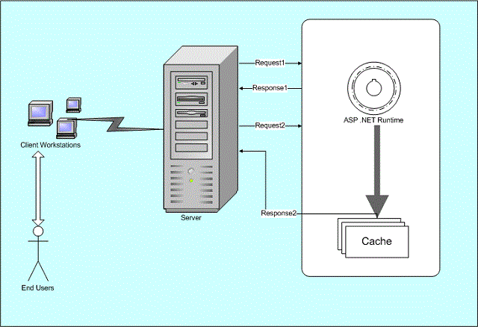
Cache Diagram

Slide 11
Types of Caching
Page Output Caching
2. Partial Page Caching/Control Caching/Fragment Caching
3. Data or Data Source Caching

Slide 12
1. PAGE OUTPUT CACHING
Page Output Caching enables you to cache the entire rendered contents of a page in memory.
The next time that any user request the same page , the page is retrieved from the cache.

Slide 13
Using Page Output Caching
To enable page output caching <%@OutputCache %> directive is used.
Example 1. PageOutputCaching.aspx : The page caches its content for 15 seconds.
If you refresh the page multiple times , the time is not updated until 15 seconds have passed.

Slide 14
Page Output Caching Example 1:
PAGE OUTPUT CACHING
<%@ OutputCache Duration="15" VaryByParam= "none" %>

Slide 15
2. PARTIAL PAGE CACHING
It enables us to get around this problem by enabling us to cache only particular regions of a page.
By taking advantage of partial page caching, we can apply different caching policies to different areas of a page.

Slide 16
2. PARTIAL PAGE CACHING Contd…
--------------- WebUserControl1.ascx-------------------------
<%@ Control Language="C#" AutoEventWireup="true" CodeFile="WebUserControl1.ascx.cs" Inherits="WebUserControl1" %>
<%@ outputcache duration="60" varybycontrol=“none" %>
<script runat="server">
private int _Departmentid=0;
void Page_Load(Object sender, EventArgs e)
{
lblText.Text = "Time is " + DateTime.Now.ToString() + " for Department id = "
+ _Departmentid + "\n";
}
</script>
<br /><asp:Label id="lblText" runat="server"></asp:Label>

Slide 17
2. PARTIAL PAGE CACHING Contd…
<%@ Page Language="C#" AutoEventWireup="true" CodeFile="Partialcashing.aspx.cs" Inherits="Partialcashing" Trace="false"%>
<!DOCTYPE html PUBLIC "-//W3C//DTD XHTML 1.0 Transitional//EN" "http://www.w3.org/TR/xhtml1/DTD/xhtml1-transitional.dtd">
<%@ Register TagPrefix="CacheSample" TagName="Text" src="WebUserControl1.ascx" %>
<html xmlns="http://www.w3.org/1999/xhtml">
<script runat=server>
void Page_Load(Object sender, EventArgs e)
{
this.lbltime.Text ="Base form time is " + DateTime.Now.ToString() + "\n";
}
</script>
<head></head>
<body>
<form runat="server" ID="Form2">
<asp:Label id="lbltime" runat="server"></asp:Label>
<CACHESAMPLE:TEXT id="instance1" runat="Server">
</CACHESAMPLE:TEXT>
</form>
</body>
</html>

Slide 18
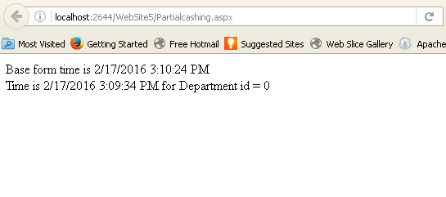
2. PARTIAL PAGE CACHING Contd…

Slide 19
3. DATA SOURCE CACHING
It is used with the different ASP.NET Datasource controls such as SqlDataSource and ObjectDataSource controls.
When we enable caching with a Datasource control, the Datasource control caches the data that it represents.

Slide 20
Using DataSource caching
It caches at the level of a DataSource control.
Three ASP.NET DataSource controls –SqlDataSource,ObjectDataSource and
XmlDataSource –include properties that enable us to cache the data that DataSource control represents.

Slide 21
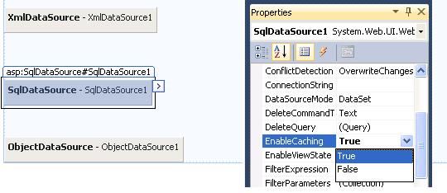
Using DataSource caching

Slide 22
Application Tracing and Error Handling in ASP. Net

Slide 23
Error Handling
When errors occur in an ASP.NET application, they either get handled or propagates unhandled to higher scopes.
When an unhandled exception propagates, the user may be redirected to an error page using different ASP.NET configuration settings.
However, such a redirection may be prevented in the first place by handlingthe exceptions that get thrown.
Error handling in ASP.NET therefore, may be divided into two separate logics:
Redirecting the user to an error page when errors go unhandled.
Handling exceptions when they get thrown.

Slide 24
Handling exceptions
The try-catch statement consists of a try block followed by one or more catch clauses and/or finally clause, which specify handlers for different exceptions.

Slide 25
Handling exceptions Cont…
protected void Button1_Click(object sender, EventArgs e)
{
try
{
Response.Write(Int32.Parse(TextBox1.Text) / Int32.Parse(TextBox2.Text));
}
catch (Exception exc)
{
Response.Write(exc.Message);
}
}

Slide 26
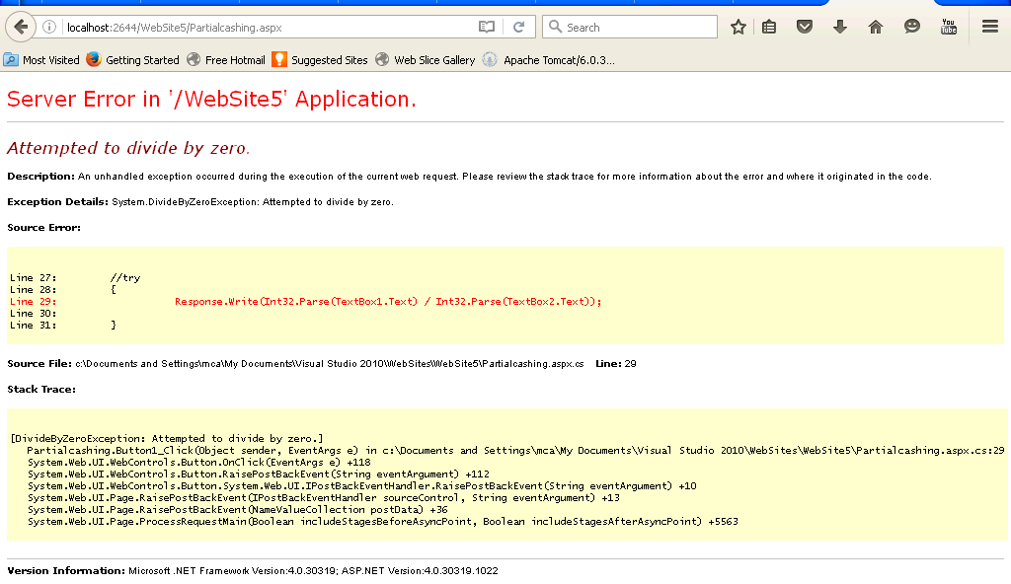
Handling exceptions Cont…
The output of the Program without using try Catch Block.

Slide 27
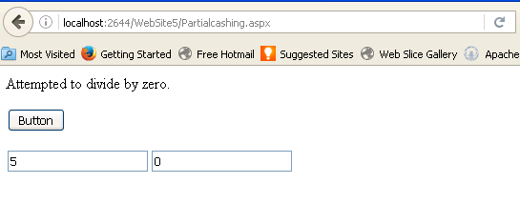
Handling Exceptions Cont…
The output of the Program using try Catch Block.

Slide 28
Error Handling
Although ASP.Net can detect all runtime errors, still some subtle errors may still be there
Hence, to intercept such occurrence, you can add error handing settings in the web.config file of the application. It is application wide error handling. For example, you can add the following lines in the web.config file:

Slide 29
Error Handling Cont…
web.config
<customErrors mode="On"
defaultRedirect="errorpage1.aspx">
</customErrors>
<!--
Create an aspx page with the name "errorpage1.aspx" having the following label atleast
<asp:Label ID="Label1" runat="server" Text="Error Occurs"></asp:Label>
-->

Slide 30
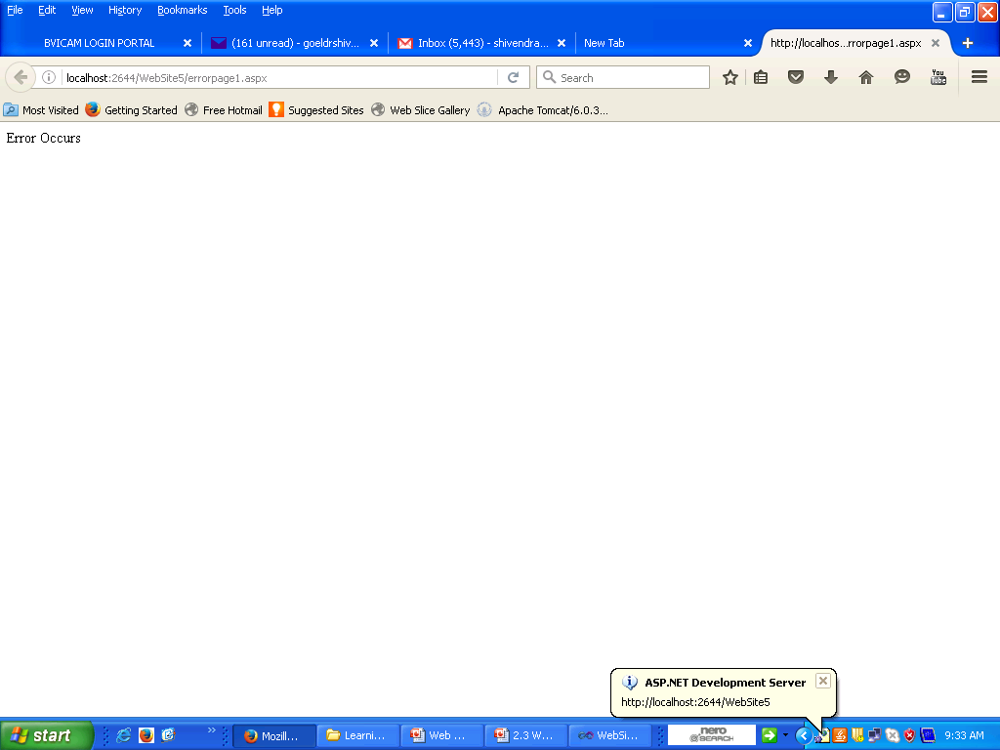
Error Handling Cont…

Slide 31
Tracing
ASP.NET tracing enables you to view diagnostic information about a single request for an ASP.NET page. ASP.NET tracing enables you to follow a page's execution path, display diagnostic information at run time
To enable page level tracing, you need to modify the Page directive and add a Trace attribute as:
<%@ Page Language="C#" AutoEventWireup="true" CodeBehind="Default.aspx.cs" Inherits="errorhandling._Default"
Trace ="true" %>

Slide 32
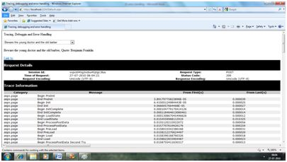
Tracing Contd..
Now when you run the file, you get the tracing information:

Slide 33
Tracing Contd..
It provides the following information at the top:
Session ID (The session identification for the specified request)
Status Code (The status-code value associated with the response)
Time of Request (The time that the request was made)
Type of Request (The HTTP method (GET or POST))
Request and Response Encoding (The character encoding for the request.)

Slide 34
Contd..
The status code sent from the server, each time the page is requested shows the name and time of error if any.
Under the top level information is the Trace log, which provides details of page life cycle. It provides elapsed time in seconds since the page was initialized.
The next section is control tree, which lists all controls on the page in a hierarchical manner.

Slide 35
Authentication and Authorization
Authentication: Authentication is the process of determining the identity of a user based on the user’s credentials. The user’s credentials are usually in the form of user ID and password, which is checked against any credentials' store such as database. If the credentials provided by the user are valid, then the user is considered an authenticated user.
Authorization: After successful authentication, deciding which resources a user can access based on their identity and checking whether the authenticated user has sufficient rights to access the requested resource is authorization.

Slide 36
Authentication mode
Provider | Description
Windows | Windows authentication is used together with IIS authentication. The Windows authentication provider relies upon IIS to perform the required authentication of a client. After IIS authenticates a client, it passes a security token. This is the default setting.
Forms | Requests that are not authenticated are redirected to an HTML form using HTTP client-side redirection. The user provides his login information and submits the form. If the application authenticates the request, the system issues a form that contains the credentials or a key for reacquiring the identity.
Passport | A centralized authentication service provided by Microsoft that offers single login and core profile services for member sites. This mode of authentication was de-emphasized by Microsoft at the end of 2004.
None | No authentication mode is in place with this setting.

Slide 37
Forms Authentication
This authentication mode is based on cookies where the user name and the password are stored either in a text file or the database. After a user is authenticated, the user’s credentials are stored in a cookie for use in that session.
Many time we would like to implement single sign on across multiple sites. This can be done using forms authentication. You can implement forms authentication in both the websites with same machine key. Once the validation is done in one website a cookie text file will be created. When that user goes to the other website the same cookie file will used to ensure that the user is proper or not. File as shown below:
Example in web.config
<configuration>
<system.web>
<authentication mode="[Windows/Forms/Passport/None]">
</authentication>
</system.web>
</configuration>

Slide 38
Windows-Based Authentication
Windows-based authentication is handled between the Windows server where the ASP.NET application resides and the client machine.
In a Windows-based authentication model, the requests go directly to IIS to provide the authentication process.
This type of authentication is quite useful in an intranet environment where you can let the server deal completely with the authentication process — especially in environments where users are already logged onto a network. In this scenario, you simply grab and utilize the credentials that are already in place for the authorization process.

Slide 39
Creating Users
Creating Users
You use aspects of Windows-based authentication to allow specific users who have provided a domain login to access your application or parts of your application.
Because it can use this type of authentication, ASP.NET makes it quite easy to work with applications that are deployed in an intranet environment.
If a user has logged onto a local computer as a domain user, he will not need to be authenticated again when accessing a network computer in that domain.

Slide 40
Contd…
The following steps show you how to create a user. It is important to note that you must have sufficient rights to be authorized to create users on a server. If you are authorized, the steps to create users are as follows:
Within your Windows XP or Windows Server 2003 server, choose Start-->Control Panel-->Administrative Tools-->Computer Management. If you are using Windows Vista, choose Start-->Control Panel-->System and Maintenance-->Administrative Tools-->Computer Management. Either one opens the Computer Management utility. It manages and controls resources on the local Web server. You can accomplish many things using this utility, but the focus here is on the creation of users.
Expand the System Tools node.
Expand the Local Users and Groups node.
Select the Users folder. You see something similar to the results shown

Slide 41
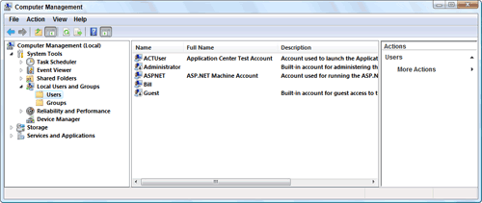
Creating user for windows

Slide 42
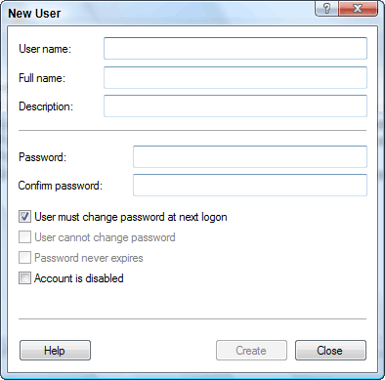
Authenticating and Authorizing a User
Authenticating and Authorizing a User
Now create an application that enables the user to enter it. You work with the application's web.config file to control which users are allowed to access the site and which users are not allowed.
Add the section presented in Listing 1 to your web.config file.
Listing 1: Denying all users through the web.config file
<system.web>
<authentication mode="Windows" />
<authorization>
<deny users="*" />
</authorization>
</system.web>

Slide 43
<authentication mode="Windows" />
Any end user — authenticated or not — who tries to access the site sees a large "Access is denied" statement in his browser window, which is just what you want for those not allowed to access your application!
Use the <allow> element in the web.config file to allow a specific user. Here is the syntax:
<allow users="Domain\Username" />
Listing 2 shows how the user is permitted access.
Listing 2: Allowing a single user through the web.config file
<system.web>
<authentication mode="Windows" />
<authorization>
<allow users=“Bubbles" />
<deny users="*" />
</authorization>
</system.web>

Slide 44
Contd..
Even though all users (even authenticated ones) are denied access through the use of the <deny> element, the definitions defined in the <allow> element take precedence. In this example, a single user—Bubbles—is allowed.
Now, if you are logged on to the client machine as the user Bubbles and run the page in the browser, you get access to the application.

Slide 45
Encryption Data over the network
If you have any sensitive data that needs to be stored.
.NET provides two main encryption roads that you can travel down including symmetric encryption and asymmetric encryption.
Symmetric encryption relies upon a private key to encrypt and decrypt while asymmetric encryption relies upon a public key to encrypt and a private key to decrypt.
Symmetric encryption provides the best performance while asymmetric encryption provides the best security in situations where keys need to be exchanged between different parties.
If you need to encrypt and decrypt data directly within an application symmetric encryption works fine as long as other prying eyes can’t get their hands on the private key (or your source code).

Slide 46
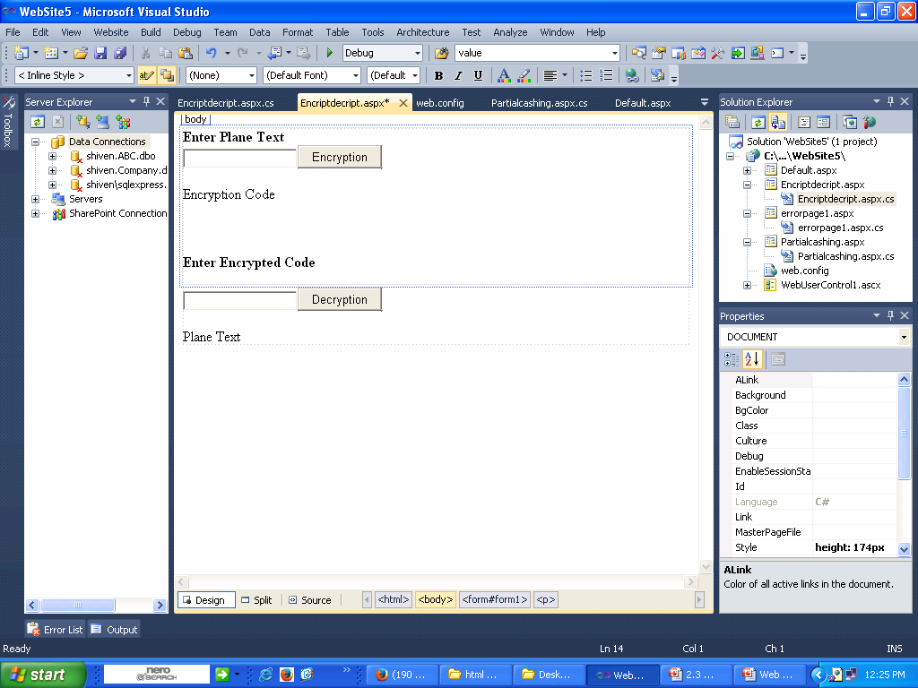
Cont..

Slide 47
Cont...
public partial class Default2 : System.Web.UI.Page
{
//Encryption Method
public string enpwd(string pass)
{
byte[] bytes = System.Text.Encoding.Unicode.GetBytes(pass);
string EncryptedPWD = Convert.ToBase64String(bytes);
return EncryptedPWD;
}

Slide 48
Cont...
//Decryption Method
public string drcpwd(string enpass)
{
byte[] bytes = Convert.FromBase64String(enpass);
string DrcptedPWD = System.Text.Encoding.Unicode.GetString(bytes);
return DrcptedPWD;
}

Slide 49
Cont...
protected void Button1_Click(object sender, EventArgs e)
{
Label1Encript.Text = enpwd(TextBox1.Text);
}
protected void Decript_Click(object sender, EventArgs e)
{
Label2Decr.Text = drcpwd(TextBox2.Text);
}
}

Slide 50
Short Questions
What is the difference between Window based and form based authentication?
What are the benefits to create sessions in a web application?
What is caching ? Briefly explain all type of caching for a web application?
Differentiate between Form-Based and Windows-Based Authentication?
How is XML used in a web application? Give syntax with an example?
Design & code a web page to implement partial page caching in a web form.

Slide 51
Short Questions
How can you encrypt data from a web page explain with example?
How can we secure ASP.NET Application by using authentication of different kind?
Design & code a web application to Track User Sessions and travel the login data using session and display on the another form.

Slide 52
Long Questions
What are user sessions? How is it helpful to travel data within the web application?
How can caching be used of different type? Write the benefits of it with example.
Briefly explain the error handling of an Application.
How can we secure ASP.NET Application by using authentication of different kind?
What are sessions? Why we use it. Give an example to use session in a web application?

Slide 53
Long Questions
What are the benefits to use caching in a web application and briefly explain all type of caching?
How can we handle the errors of a web application show with an example?
Design & code a web application to authenticate all form using Form-Based Authentication and redirect all to login.aspx.

